Slide 1
The First World War did not end neatly. The end of the war was accompanied by the collapse of four empires: Imperial Germany, Tsarist Russia, Austria-Hungary, and the Ottoman Empire. This collapse of the old order brought massive economic and political instability. Despite the armistice between Germany and the Allies, many conflicts continued to rage. In the months after the armistice, wars and revolutions caused major upheavals in Central and Eastern Europe, and in the Far East. It was hoped that the Paris Peace Conference would provide an all-encompassing peace settlement and a new world order based on President Wilson’s Fourteen Points. But the complex details of the peace treaties caused endless disputes. Between 1919 and 1923, numerous border conflicts were fought out to decide what the outcomes of the First World War and of the peace settlements would really mean in practice.
The aftermath of the First World War was a time of hopes and fears. There was great hope that there would be a new age of democracy and national self-determination, underpinned by the League of Nations, with the ‘Versailles System’ ensuring long-term international peace. There was hope that there would be worldwide economic recovery, underpinned by modernity, science and progress. Equally, there were deep-rooted fears: that the post-war peace settlement carried within itself the seeds of future wars. In the mid-1920s, nobody could know whether hopes or fears would be fulfilled. It was still an uncertain peace.

Slide 2
The continuation of conflicts
The armistice of 11 November 1918 brought the First World War to an end but it did not bring peace everywhere. There were widespread continuing conflicts, especially the Russian Civil War, with wide-ranging battle fronts in Northern Russia, Ukraine and the Black Sea, and in the Far East. Revolutions and civil conflicts raged in Germany, Hungary, Ireland and in the former Ottoman Empire. Some of these conflicts subsided relatively quickly, but they left a dangerous and unstable legacy that contained the seeds of many potential future conflicts. When the great post-war peace conference commenced in Paris early in 1919, the peacemakers inherited a situation that was volatile, complicated and dangerous.

Slide 3
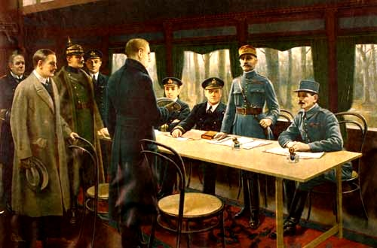
The armistice at Compiègne
(Wikimedia Commons, Public Domain)
The armistice that brought an end of hostilities between Germany and the Entente Powers was signed at a brief ceremony held in a railway carriage at Compiègne, at 11.00 on 11th November 1918. The armistice did not ‘end all wars’ as was hoped. The armistice was merely a truce, pending formal peace negotiations that were to take place in Paris in 1919. And, although fighting ceased on the Western Front, many conflicts continued to rage elsewhere. A painting of the signing of the Armistice at Compiègne, northern France, in November 1918. The Allied supreme commander, Marshal Foch, stands opposite the German delegation.

Slide 4
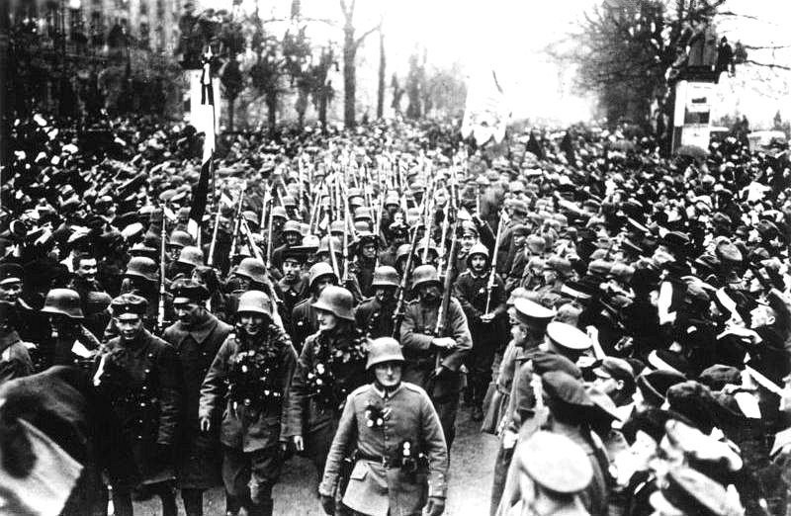
Freikorps
(German Federal Archive, CC BY-SA 3.0)
After the signing of the armistice it became necessary to demobilise millions of troops stationed on the battle fronts. This was a complicated and lengthy process for all the nations participating in the war. It was especially difficult for Germany after the collapse of the Imperial German regime. Huge numbers of ex-soldiers made their way home, often in a very disorganised fashion. Many units stuck together in unofficial groupings that became known as ‘Freikorps’ (Free Armies).
In the chaotic conditions of late 1918 and early 1919, these Freikorps units became a potentially powerful political force for those who wished to counter the ‘German Revolution’. German troops returning home from the Western Front in December 1918. Many of these soldiers joined units of the Freikorps to help crush left-wing revolutionaries in Bavaria and Berlin.

Slide 5
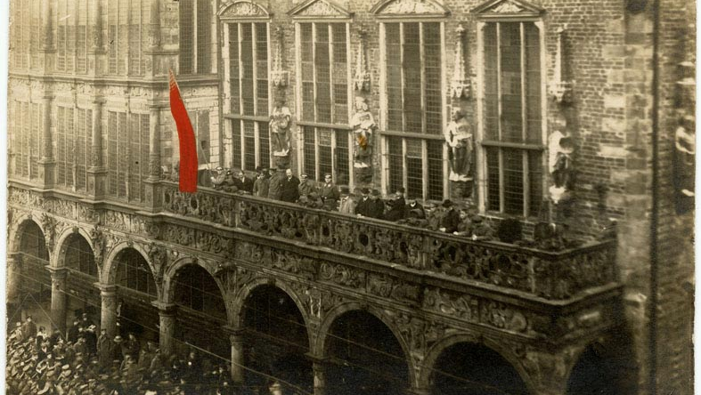
The German Revolution
Proclamation of the Bremen Revolutionary Republic, 15/11/1918. In those troubled months, local workers’ council briefly took power in a number of German cities but these were mainly crushed by the Provisional Government, with the help of the army, the Freikorps and right-wing politicians.
(Staatsarchiv Bremen, CC BY-SA 3.0 unported)
The ‘German Revolution’ of 1918-1919 grew out of months of strikes and demonstrations that coincided with the end of the war and the collapse of the Kaiser’s imperial government. German sailors mutinied and refused to carry on fighting. Revolts in the ports of Wilhelmshaven and Kiel led to civil unrest, which quickly spread to other parts of Germany. In October 1918 the Kaiser attempted to transform the German political system into a Parliamentary Monarchy with a provisional government led by the moderate Social Democratic Party (SPD). The unrest continued. On 9 November 1918 the Kaiser abdicated, as did the rulers of the other German states. The SPD and its leader, Friedrich Ebert, led the new Provisional Government but the German left was bitterly divided. The USPD (Independent German Socialist Party) was committed to outright revolution as was the new German Communist Party. There was a breakaway government in Bavaria, led by the radical socialist Kurt Eisner. The USPD formed Soviet-style councils in a number of German cities, including Kiel and Bremen. Ebert’s government increasingly relied on military force from the Army and from the Freikorps to retain control. However, the civil unrest could not be stopped.

Slide 6
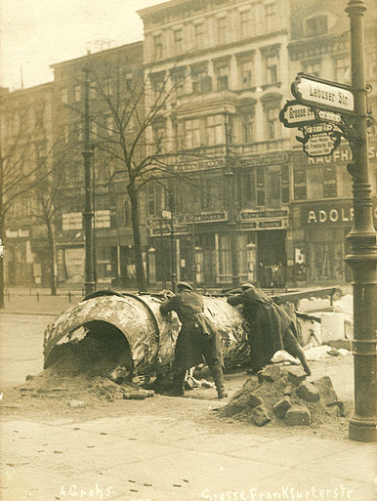
The Spartacist uprising
The Kiel Mutiny was ended peacefully by ministers of the new Provisional Government but the unrest at Kiel and Wilhelmshaven was part of a much wider left-wing revolt. In Berlin, on 31 December 1918, the Spartacist leaders, Rosa Luxemburg and Karl Liebknecht announced the formation of the German Communist Party (KPD) and called for the overthrow of the Provisional Government. In January 1919 a wave of demonstrations spread across much of Germany. Berlin was particularly affected, with working class districts taken over by heavily armed left-wing militias. A state of civil war existed between the revolutionary ‘Spartacists’ and the moderate SPD provisional government of Friedrich Ebert. Negotiations failed to ease the situation, and the Ebert government was forced to turn to the Army for support. The Army sent in the Freikorps, which brutally disposed of the demonstrators. In the violent aftermath of the revolt, Rosa Luxemburg and Karl Liebknecht were arrested and shot.
A barricade in Berlin, January 1919. The Spartacist uprising forced the Ebert government to use massive military force by the Army and the Freikorps.
(Bundesarchiv Deutschland, Provider: Alfred Grohs, CC BY-SA 3.0 unported)

Slide 7
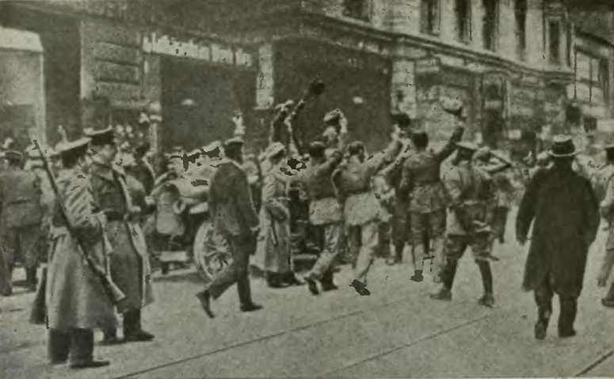
The Bavarian Republic
Soldiers of the German Army cheering the proclamation of the Bavarian Republic, 8 November 1918.
(www.archive.org, Public Domain in the USA)
In Bavaria the left-wing socialist Kurt Eisner declared the overthrow of the monarchy in Bavaria, and the formation of a Bavarian Republic. Eisner was assassinated by a right-wing nationalist in February 1919 but attempts to restore order failed. Bavaria became a separatist ‘Soviet Republic’; then Communists seized power in a coup in mid-April 1919. As with the Spartacist uprising in Berlin, the Ebert government turned to the Army and the Freikorps. 40 000 troops were deployed to Munich to crush the separatist regime. Its leaders were shot out of hand and there were brutal acts of repression and retribution. These events provided a violent backdrop to the peace negotiations going on in Paris at the time.

Slide 8
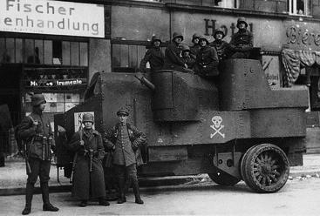
The Kapp Putsch
Freikorps soldiers during the Kapp Putsch 1920.
(Flickr, Public Domain)
Even after the Spartacist revolt was crushed, the German Republic faced many further violent revolts, both from the Left and from the Right. The Freikorps were involved in many other actions: to suppress the separatist regime that was established in Bavaria, and to fight battles against Poles and Lithuanians to defend Germany’s eastern borders. In 1920, Freikorps units took part in a failed coup against Ebert’s government, the so-called Kapp Putsch. It was only late in 1923 that the last of these threats was suppressed and the period of post-war violence came to an end.

Slide 9
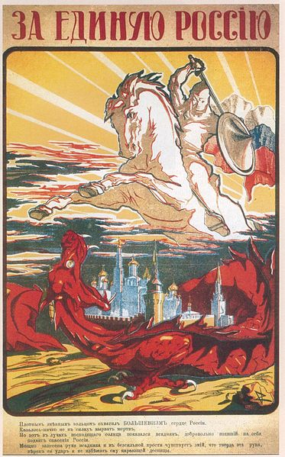
The Russian Civil War
The two revolutions in Russia in 1917 led to years of upheaval and civil war. The fall of the Tsar brought a number of competing political groups to the fore and briefly raised hopes that Russia might have a democratic future. After the Bolsheviks seized power in November 1917, a loose coalition of radically different forces emerged united only in their opposition to Bolshevism. These anti-Bolshevik groups included royalists, liberals, republicans, and landowners, as well as dissident Communists and the Social Revolutionaries. Anti-Bolshevik resistance quickly turned to armed conflict leading to a civil war. The anti-Bolshevik coalition, known as the “Whites” (in opposition to the “Reds” or Red Army) seemed to be successful until the second half of 1919, when the Red Army, led skillfully by Leon Trotsky, turned the tide against them. The Red Army had a key advantage in its central position, where the White armies were scattered over vast distances; Trotsky was also brilliantly effective in forcibly conscripting peasants and former Tsarist army officers into the Bolshevik military machine.
‘For a United Russia’, White propaganda poster, 1919.
The text tells the story of how a fierce dragon had encircled a city, but was ultimately defeated by a valiant knight.
(Wikimedia Commons, Public Domain)

Slide 10
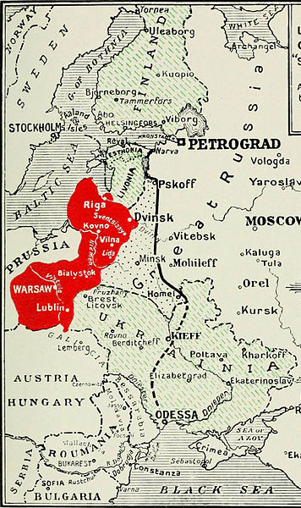
Allied Intervention in Russia
The prospect of the Bolsheviks making a separate peace with Germany had led to Russia’s allies - Britain, France, the United States and Japan – sending troops to Russia from February 1918 onwards to try and keep Russia in the war. This Allied Intervention continued beyond the armistice on the Western Front in November 1918, even though its original purpose had become irrelevant. This was mainly because the Allies feared that the mass of military supplies and equipment that they had sent to Russia could fall into German hands. As a result the Allied intervention forces became increasingly involved in the Russian Civil War, on the side of anti-Bolshevik forces, particularly the ‘Whites’.
By spring 1919, the Western powers were withdrawing their intervention forces and this further weakened the ‘Whites’. The White forces in Southern Russia had to withdraw to Crimea, and finally surrendered in November 1920. In Siberia and the Far East, ‘White’ forces disintegrated and in some instances even handed their commanders over to the Bolsheviks. The Whites were finally defeated in October 1922 after Vladivostok was taken. However, rebellions in Central Asia lasted in some cases for the whole of the 1920s.
This map shows changes to the Russian frontiers as fixed by the Brest-Litovsk Treaty, from a contemporary American atlas (1921).
(George H. Allen: The Great War, Volume 5: The Triumph of Democracy., Philadelphia 1921. Public Domain in the USA)

Slide 11
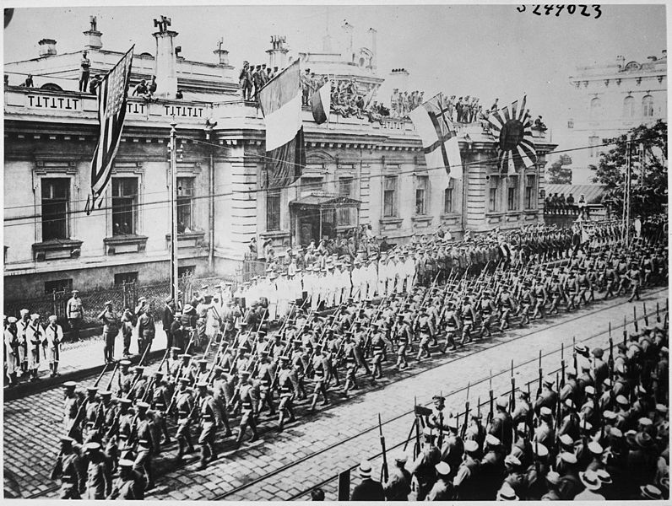
The isolation of Russia
Parade of Allied Intervention forces outside the Allied Headquarters building in Vladivostok, 1918. Soldiers and sailors from many nations, including Japan, Britain and the United States, took part in the intervention in the Far East.
(Library of Congress, Public Domain)
The Allied Intervention in Russia was on a considerable scale and lasted for a long time.
The Bolsheviks believed that the Allied Intervention was an all-out attempt by the capitalist powers to strangle Soviet Communism at birth. This was not really true; the aims of the Allies were actually confused and half-hearted (and politically unpopular at home). But the Allied forces in Russia did get sucked into local situations where they were supporting anti-Bolshevik forces. In northern Russia Allied armies and the British Navy supported White forces and also the 11 000 Estonians fighting for independence. French and British forces also played a large role in the fighting in southern Russia and around the Black Sea. In the Far East, 11 000 American troops were stationed at Vladivostok, alongside 2000 Chinese and many thousands of Japanese troops.
The circumstances of the civil war and the Allied Intervention in Russia help to explain why Soviet Russia was not present (or invited) at the Paris Peace Conference. This isolation of Russia was a key factor in weakening the whole post-war peace settlement.

Slide 12
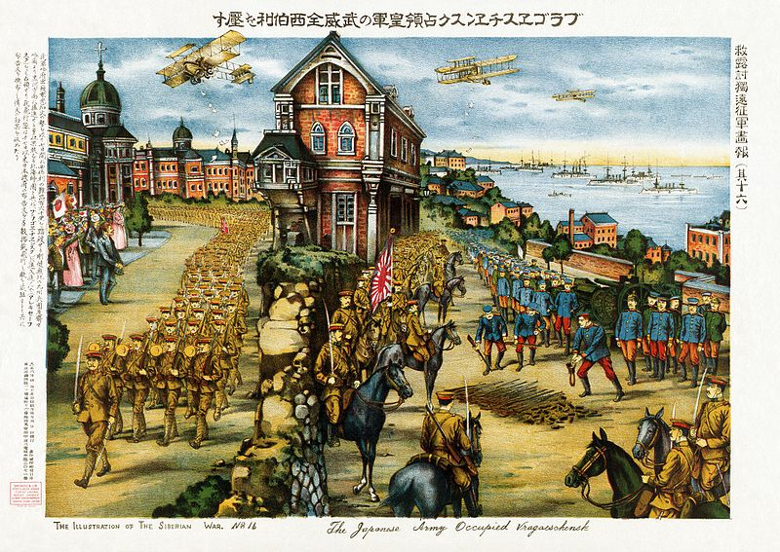
Japanese troops in Siberia
Japanese troops occupying Blagovaschenk in Siberia, 1919.
(Library of Congress, Public Domain in the USA and Japan)
In 1917 France had asked Japan to join the Allied intervention in Russia against the Bolsheviks. At first the Imperial Japanese government declined to take part. But in February 1918 it was decided to send Japanese troops to support the Whites and occupy Siberia. The objective was to make the region an independent buffer state between Russia and the Sea of Japan.
After the other Entente powers withdrew their intervention forces from Russia Japanese troops remained in Siberia and for nearly two years repulsed attacks by the Red Army. However, the cost of the occupation created opposition in Japan and in October 1922 the Imperial Japanese Government withdrew from Siberia.

Slide 13
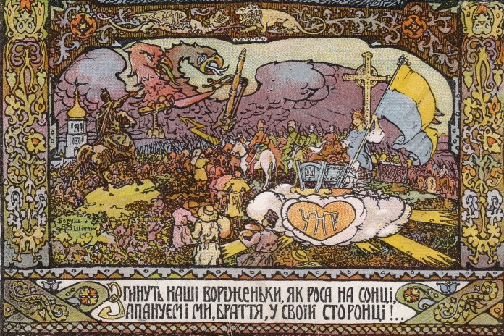
Ukrainian independence
Propaganda poster promoting independence for Ukraine after the collapse of the Russian Empire in 1917.
(Wikimedia Commons, Public Domain)
The absence of strong central authority also led to a wave of wars of national independence: in the Baltic States, in Ukraine, Armenia and Georgia. These wars of independence were in full swing when the war in the West ended, and carried on long afterwards.
Ukrainians were one of the largest national minorities in the Russian Empire. The collapse of Tsarist rule early in 1917 awakened strong nationalist feelings, and the Bolshevik seizure of power in October/November 1917 intensified them. For the Soviet leadership, loss of Ukraine was unthinkable. This led to a prolonged war of independence that persisted for four years. There were many different factions in the struggle, linked by a common thread of Ukrainian language and culture. The most important military leader was Symon Petliura, who proved to be an inspiring and charismatic military commander, and who later formed a powerful alliance with the Polish leader Josef Pilsudski.

Slide 14
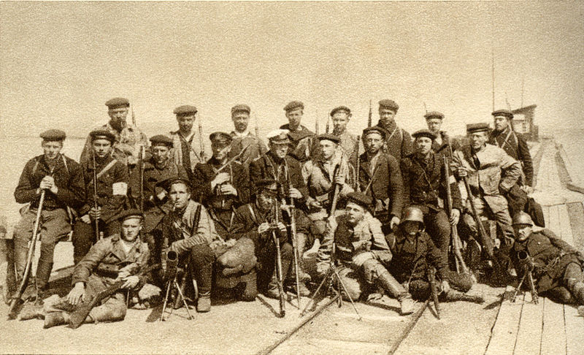
Estonian independence
Volunteer soldiers fighting for Estonian Independence, May 1919.
(Wikimedia Commons, Public Domain)
In addition to the struggle for independence in Ukraine many other nationalities also hoped for independence, including Ukrainians, Armenians and Georgians. In the Baltic Sea region, Estonians, Latvians and Lithuanians were ready to fight for independence. Their links to Russia had already been broken, at least temporarily, when the Treaty of Brest-Litovsk ceded them to Germany. In Estonia, independence was proclaimed in Tallinn in February 1918. Then began a long draining war against Soviet forces until independence was finally secured by victory in the Battle of Krivasoo in December 1919. A peace treaty formalising Soviet recognition of independent Estonia was signed in January 1920.
By 1918 it was also clear that those Poles previously ruled by Russia would become part of a new independent Poland after the war.

Slide 15
The flawed peace settlement and new border conflicts
In January 1919 there was worldwide optimism that the Paris Peace Conference would establish the foundations of long-term peace through disarmament, the formation of the League of Nations and the principles of collective security and self-determination. In 1919 and 1920, five peace treaties set out the borders of the new nation states that emerged from the collapse of the Russian, Ottoman, Austro-Hungarian, and German Empires. But this ‘Versailles System’ failed to resolve all existing threats to future peace or to satisfy the aspirations of the new nation states. One example of this was the failure of the Treaty of Sèvres to establish accepted borders for Turkey. In 1923, after a bitter war between Turkey and Greece, the Treaty of Lausanne imposed new borders. Thus, the post-war settlement provoked conflict over old grievances and created many new tensions. The maintenance of future peace was far from assured.

Slide 16
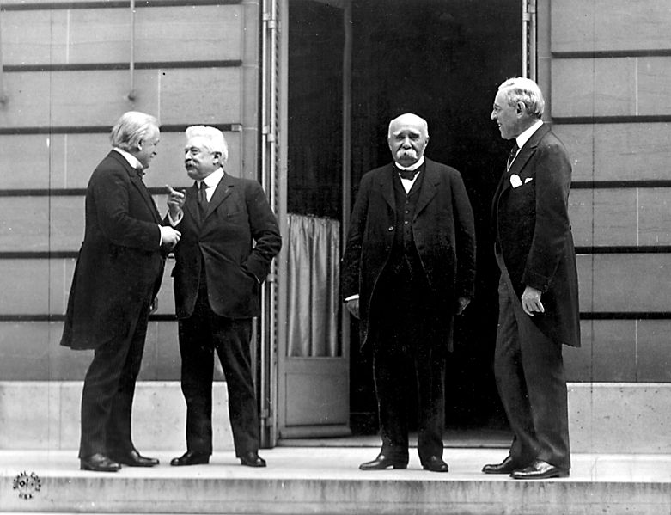
The Paris Peace Conference
‘The Big Four’, Paris, 27 May 1919. From left to right: Lloyd-George (Britain); Orlando (Italy); Clemenceau (France); Wilson (United States).
(US Army Signals Corps, Public Domain)
The Peace settlement which formalised the end of the War consisted of a series of Treaties between the Allies and the defeated Central Powers. The Paris Peace Conference lasted from January 1919 to August 1920. The treaties with the five defeated powers took their names from the palaces where the signature ceremonies took place. The Treaty of Versailles (with Germany), 28 June 1919. The Treaty of Saint-Germain (with Austria), 10 September 1919. The Treaty of Neuilly (with Bulgaria), 27 November 1919. The Treaty of Trianon (with Hungary), 4 June 1920. The Treaty of Sèvres (with Ottoman Turkey), 10 August 1920. The negotiations were dominated by the ‘Big Four’ victorious powers: the United States, France, Britain and Italy. Relations between the leaders were not easy. Russia was not present. It was now an ‘outlaw’ state in the midst of civil war. There were many political differences, often exacerbated by language barriers. The Italian prime minister, Orlando, started to be side-lined by the other three allied leaders. There were divergences between President Wilson and the ‘old imperialists’ Clemenceau and Lloyd George. Both Wilson and Lloyd George often had private discussions with their teams of advisers to discuss strategies before meeting the others leaders.

Slide 17
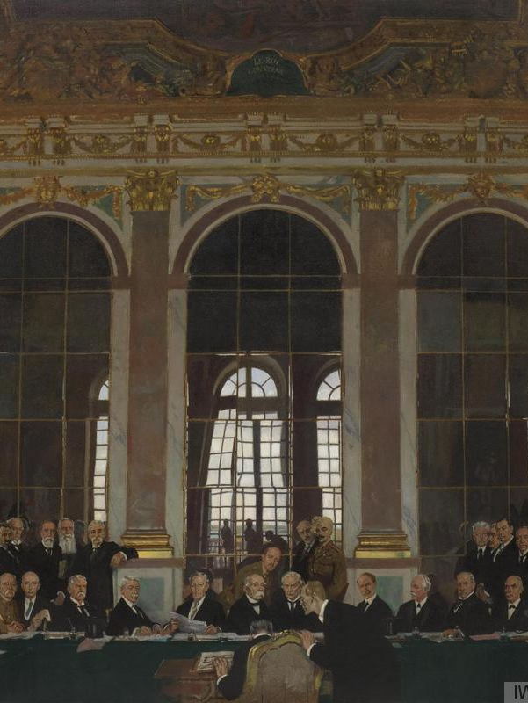
The Treaty of Versailles
In the vengeful mood that followed the Allied victory over Germany, there was a desire to make a treaty that would be very harsh, both in its terms and also symbolically. Thus, the Treaty of Versailles was an imposed, take-it-or-leave-it peace, with little or no room for Germany to negotiate. German politicians resisted this ‘Diktat’ as far as they could before yielding to the inevitable and signing the Treaty, which they regarded as excessively demanding and unfair. German diplomats at Versailles, representing the government of the democratic Weimar Republic, felt there should be recognition of the fact that Germany was not to blame for starting the war, and that their government, after all, had overthrown the militaristic regime of the Kaiser.
The Signing of Peace in the Hall of Mirrors, Versailles, 1919; Artist: William Orpen. The man signing the Treaty is Johannes Bell, then Minister for Transport in the German Government.
(Imperial War Museum (Art.IWM ART 2856), re-usable under IWM Non-Commercial Licence)

Slide 18
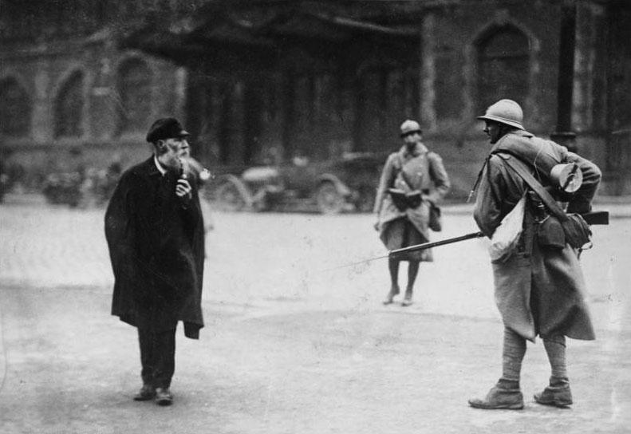
The occupation of the Ruhr
French soldiers in the Ruhr, 1923. The occupation was one of the strongest reasons why German citizens continued to resent the terms of the Treaty of Versailles.
(Bundesarchiv, Bild 183-R09876 / CC-BY-SA 3.0)
Political and public opinion in Germany reacted angrily against many of the terms imposed by the Treaty of Versailles. There was particular public resentment about: the seizure of German colonies, which were to be converted into League of Nations mandates; the ‘war guilt clause’ which Germany had to sign to accept blame for starting the war in 1914; the loss of German-speaking populations to other countries, such as Poland and Czechoslovakia; the imposition of huge reparations payments by Germany to compensate her enemies for war damage; and the ‘guarantees’, through which the Allies seized control of a number of important towns and bridgeheads along the Rhine (such as Cologne and Mainz), for five to fifteen years, to ensure that Germany would not reject its obligations.
In 1923, when the German government temporarily refused to pay reparations, French troops occupied the vital industrial region of the Ruhr, to enforce the terms of the Versailles treaty.

Slide 19
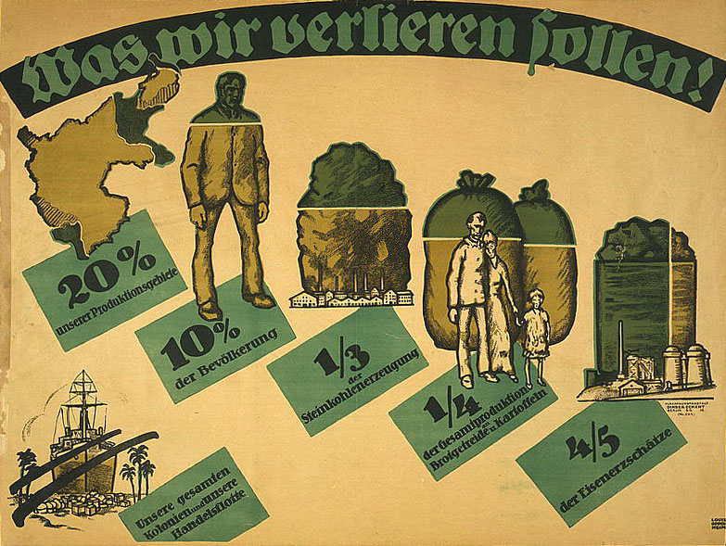
German resentment
Was Wir Verlieren Sollen! (What We Germans Will Lose!) A German poster protesting against the possibility of Silesia being awarded to Poland.
(Library of Congress, Public Domain)
There was particular resentment in Germany against the idea that the Versailles treaty was a ‘dictated peace’ denying Germany the chance to negotiate; and of the imposition of huge reparations payments that would cripple the German economy for years to come. In this mood of resentment, many Germans attacked perceived external enemies and internal ‘traitors’ alike.
In the autumn of 1919 General Erich Ludendorff, the German Army’s Chief-of-Staff, alleged that the army had been “stabbed in the back”, particularly by the
Politicians who had signed the Armistice and proclaimed the Weimar Republic. This claim was then picked up by public opinion and the press in Germany who also kept the legend of the ‘stab in the back’ alive, i.e. the idea that Germany was nor defeated on the battle fronts but by ‘unpatriotic elements’ on the home front.

Slide 20
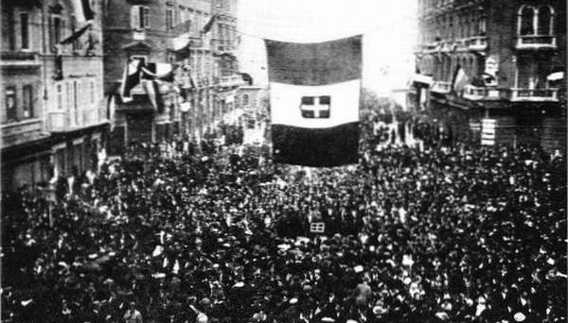
The occuputaion of Fiume
Crowds cheering Gabriele d’Annunzio and his volunteer army in the disputed city of Fiume (Rijeka), September 1919.
(Wikimedia Commons, Public Domain)
Dissatisfaction with the peace treaties was not confined to Germany. It was also intense in Hungary and Turkey. Even some victorious powers were dissatisfied. Many Italians believed the terms of the peace settlement disadvantaged Italy. There were widespread protests against the ‘Mutilated Victory’, claiming that the heroic Italian contribution to victory had not been recognised.
In 1919, the nationalist poet and dramatist, Gabriele d’Annunzio, led an army of to occupy the port of Fiume, which had been awarded to Yugoslavia, not to Italy.
The occupation of Fiume lasted many months and greatly weakened the position of the Italian government and helped to create the climate for Mussolini’s rise to power from 1922. In January 1924 the governments of Italy and the Kingdom of Serbs, Croats and Slovenes signed a treaty agreeing to the Italian annexation of Fiume.

Slide 21
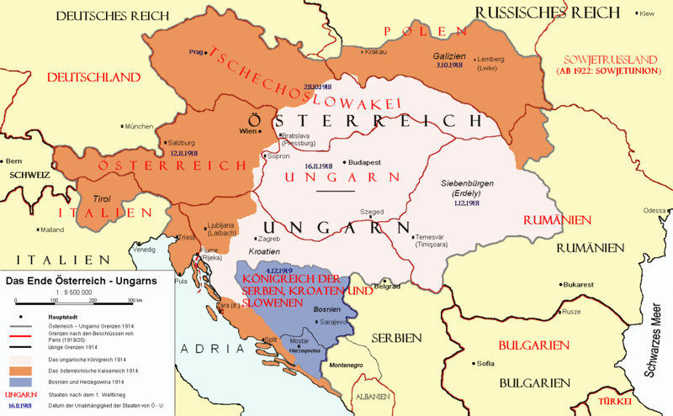
The disintegration of Austria-Hungary
A map of the new borders of the former Austria-Hungary, superimposed over its former borders. (Hungary is Ungarn in German).
(Wikimedia Commons, Creator: AlphaCentauri (2004), CC BY-SA 3.0 unported)
One of the major problems in the post-war peace settlement was the complexity of the new borders established after the collapse of the multinational empire of Austria-Hungary. The intermingling of ethnic populations in Austria-Hungary made it very difficult to apply the principle of self-determination. This led to border disputes affecting Italy, Poland and Ukraine, Yugoslavia, and Czechoslovakia.
The treatment of the former Kingdom of Hungary was a particularly difficult issue. Unlike the other Successor States that grew out of the collapse of the empire, Hungary was seen by the peacemakers as a defeated enemy. The terms of the Treaty of Trianon were harsh. Hungary lost two thirds of its former population and more than two thirds of its territory (including its access to the sea). This led to lasting resentment in Hungary, and many tensions between Hungary and neighbouring states.

Slide 22
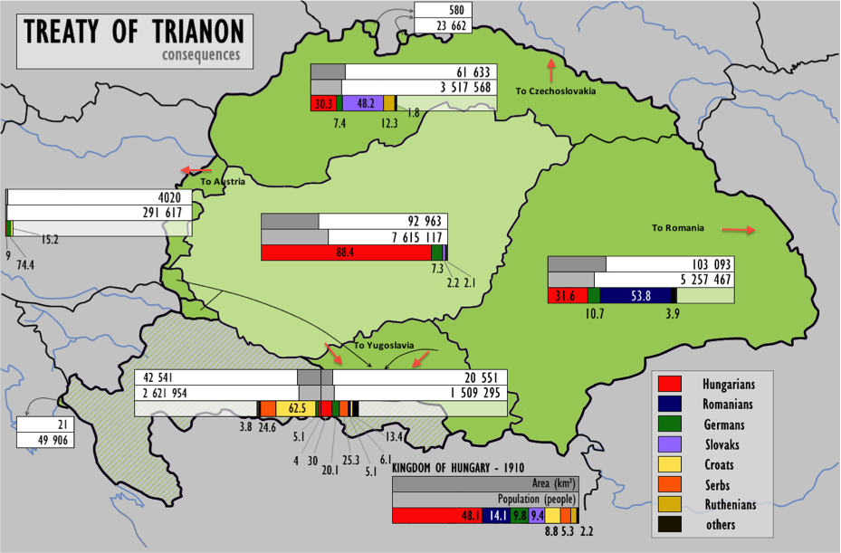
The territorial changes of the Trianon Treaty
A map depicting those parts of Hungary, as it was in 1914, which were ceded to other neighbouring countries by the Treaty of Trianon. It also shows the percentage of ethnic Hungarians remaining in those countries after 1920.
(Wikimedia Commons, Public Domain)
The terms of the Treaty of Trianon were imposed on Hungary in 1920. The treaty was delayed by internal upheavals within Hungary: in 1919 the country was a revolutionary republic, led by the Communist leader, Bela Kun. It was only after Kun’s regime was overthrown by right-wing counter revolution that the treaty was finalised. One of the main consequences, as this map shows, is that large numbers of ethnic Hungarians now found themselves living in those pars of the former Hungary that had now been ceded to other countries.
Resentment of Trianon was widely felt, stirred by nationalist politicians, and by the effects of the civil war that had engulfed the country until an authoritarian regime, the Regency, led by Admiral Horthy, took power. Under Horthy, who ruled virtually as a dictator, nationalism and resentment of Trianon remained strong. There was little chance of effective cooperation between Hungary and her neighbours.

Slide 23
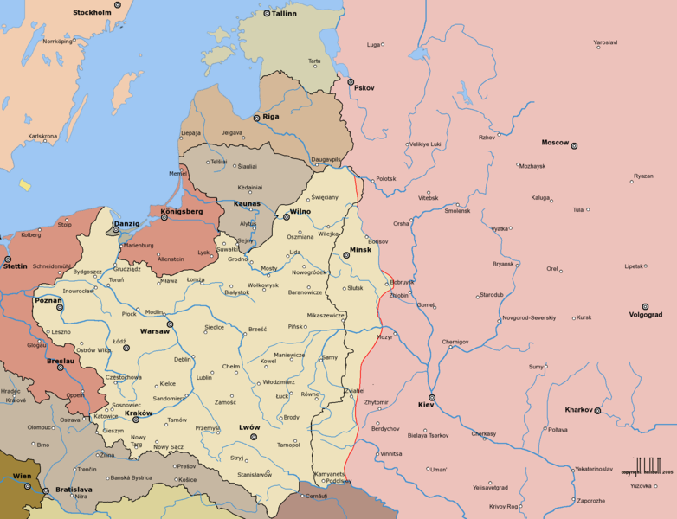
An independent Poland
Poland and its frontiers, December 1919.
(Wikimedia Commons, Creator: Halibutt, CC BY-SA 3.0 unported)
The re-creation of independent Poland was one of the central tasks of the post-war peace settlement, bringing together regions that had been ruled by the German, Russian and Austro-Hungarian empires. Finalising the borders of the new Poland was immensely difficult and Poland came into conflict with its neighbours. This included conflict with Lithuania over Wilno (Vilnius); with Germany over Upper Silesia and Danzig; with Czechoslovakia over Cieszyn (Tesin), with the short-lived government of independent Ukraine, and, above all, with Soviet Russia, with whom Poland fought two major wars in 1919 and in 1920.
One of the major weaknesses of the Paris peace settlement was that Soviet Russia, in the midst of civil war, was not involved. This meant that many aspects of the post-war peace were insecure and incomplete.

Slide 24
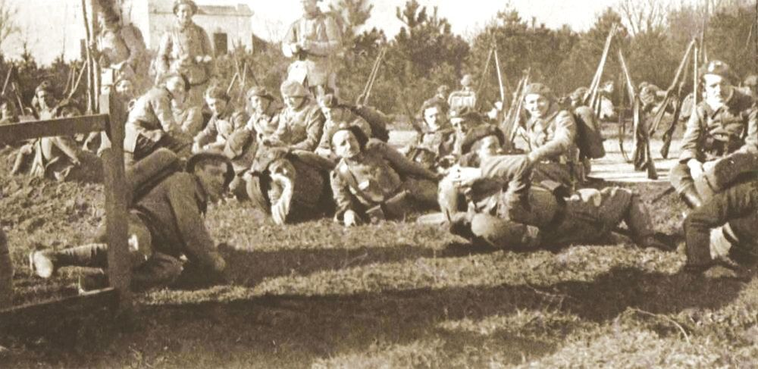
Polish-Czechoslovak War
Czech soldiers on the Polish border during the Polish-Czechoslovak War over Cieszyn (Tesin) in 1919.
(Wikimedia Commons, Public Domain)
Like other Successor States, Czechoslovakia and Poland were among the ‘winners’ in the post-war peace settlement: new (or newly restored) nation states who had gained independence with the blessing of the victorious Allied powers.
But the principle of self-determination was fiendishly complex in practice when the national and ethnic minorities of Central Europe so closely intermingled. There were many intense conflicts over territorial borders between the new states.
The Polish-Czechoslovak War of 1919 was an example of how the post-war peacemakers had to grapple with such conflicts. Cieszyn (Tesin) in Silesia was rich in coal and had a divided population. On 23 January 1919 the Czechs, who were dissatisfied with their share of the region, launched military attacks, leading to the Battle of Skoczow in which Polish forces were driven back. But the Czech advance was halted on 31 January by pressure from Britain and France. A peace treaty to resolve the frontier line was signed in Paris on 3 February 1919.

Slide 25
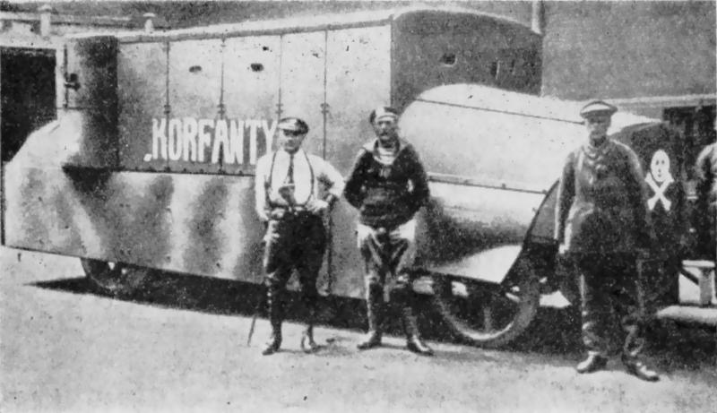
Second Silesian Uprising
Polish fighters in the Second Silesian Uprising, with ‘Korfanty’ an armoured car specially built to help the insurgents in their fight to win Upper Silesia for Poland. (The car was named after Wojtech Korfanty, who was leader of insurgent forces in the Second and Third Silesian Risings).
(Wikimedia Commons, Public Domain)
One of the many difficult ‘loose ends’ of the Treaty of Versailles was the question of Upper Silesia, a region with rich industrial resources. The population of Upper Silesia was predominantly Polish and Catholic east of the Oder River and predominantly German and Protestant to the west. The Versailles treaty decreed a plebiscite (referendum) to decide whether Upper Silesia should belong to Germany or Poland.
Before the plebiscite could be held, the First Silesian Uprising broke out in August 1919 after Polish miners were killed by German border guards, sparking a general strike. This rising was crushed by more than 20 000 German troops, many of them veterans of previous battles fought by the Freikorps. Upper Silesia continued to be disputed. In August 1920 the Second Silesia Uprising began at Katowice, and spread to other towns and cities. This was ended by diplomatic pressure from the Allied powers. But the issue remained explosive. In April 1921, the plebiscite was finally held, but many Poles protested against its ‘unfair’ implementation. This sparked the Third Silesian Rising, which began with significant advances by Polish insurgents but was eventually crushed by German border guards, supported by British and French forces who had been sent to uphold the decision of the plebiscite.

Slide 26
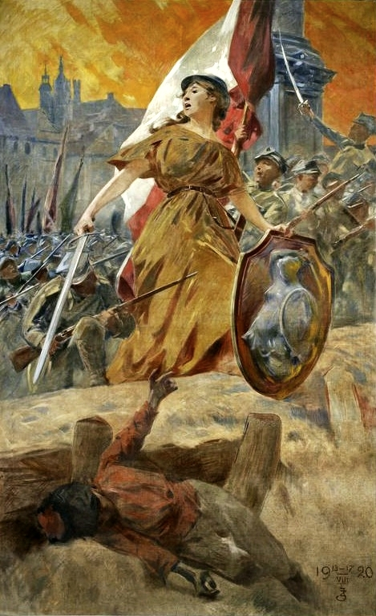
Poland and the Russian Civil War
When Poland was re-created as an independent nation after the First World War, the situation on Poland’s eastern borders was in flux. The Russian Civil War was raging; the Bolshevik regime in Russia was under serious pressure, attacked on all sides. To Poland’s north the Baltic States were fighting wars of independence; as was Ukraine in the South East. The chaotic, unpredictable events of these wars led to the Polish-Soviet War of 1919-1920.
In February 1919, Poland’s chief of state, General Josef Pilsudski, saw an opportunity to greatly expand Poland’s eastern borders. In the northern campaigns, Polish forces captured Wilno (Vilnius) in Lithuania, and then Daugavpils in Latvia. In the south east, having briefly fought a war against Ukraine, Pilsudski combined forces with Symon Petliura, the Ukrainian nationalist leader. Their armies swept eastwards, and Polish forces held a triumphant victory march in Kiev. It seemed certain Poland would take permanent possession of West Ukraine. But by early 1920, the Bolsheviks were in a stronger position. The Red Army began driving Polish forces back towards Warsaw. They seemed to be on the point of total victory but in the ‘Miracle on the Vistula’, the Battle of Warsaw in August 1920, Pilsudski’s armies achieved a dramatic victory. This effectively ended the Polish-Soviet War, and a peace treaty was signed at Riga in March 1921.
‘Forward Warsaw’: an Allegory of Victory painted by Zdislaw Jasinski to celebrate Poland’s victory in the Battle of Warsaw.
(National Museum of Warsaw, Public Domain)

Slide 27
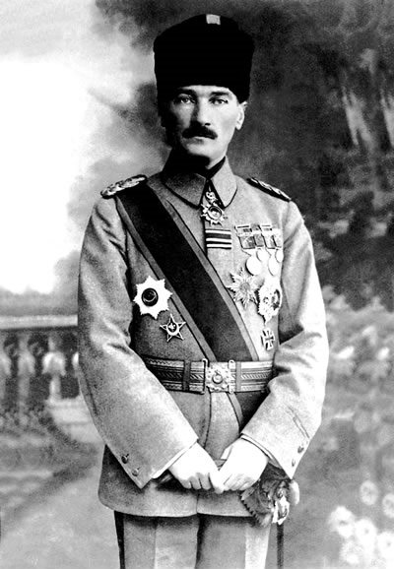
The War of Turkish Independence
The Ottoman rulers pulled out of the War on 30 October 1918, signing the Armistice of Mudros. From then on, the Allies started discussing a partition of the Ottoman Empire. This territorial dismemberment was taken further at the Paris Peace Conference that opened in January 1919.
These developments sparked unrest among Turkish troops, and especially among the Army officers. A secret network was established in Anatolia, and the officers started accumulating smuggled weapons. The highly influential army commander, Mustafa Kemal, who had achieved heroic status for his defence of Gallipoli against Allied invasion in 1915-16, took the lead in forming a Turkish National Movement.
In September 1919 the movement established a Representative Committee, which later moved to Ankara, and became a rival Parliament to the constitutional one in Istanbul. This ambiguous situation was in place while the Government of the Sultan, supported by the Allies, negotiated the peace in Paris, and signed the Treaty of Sèvres in August 1920. But Sèvres did not resolve the issues arising from the defeat and collapse of the Ottoman Empire. Under Mustafa Kemal’s leadership, a new national Turkish Republic began to take shape that refused to accept the status quo and launched a three-year War of Turkish Independence on 19 May 1919.
Mustafa Kemal (Atatürk), Hero of the Ottoman Empire, 1918
(Wikimedia Commons, Public Domain in Turkey)

Slide 28
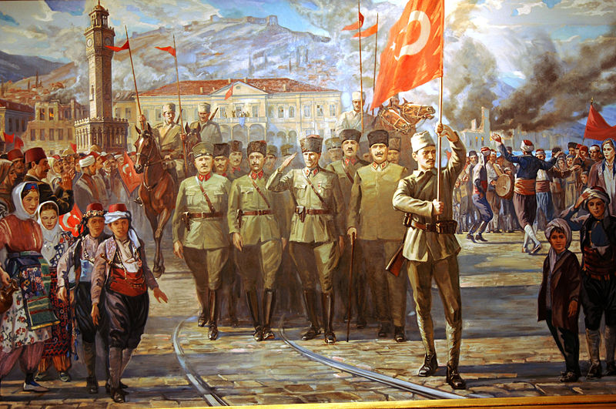
The Turkish-Greek War
The Turkish Army's entry into Izmir (Smyrna), September 1922. The painting shows a joyful crowd, while an officer proudly flies the Turkish flag. Close examination of the painting reveals its purpose as the depiction of a historical event from a particular nationalist perspective.
(Atatürk & War of Independence Museum, Public Domain)
The Turkish War of Independence was fought on many fronts but the main opponent was Greece. The Turkish-Greek war was especially long and intense, and it lasted until the complete withdrawal of Greek forces in October 1922. It featured ethnic cleansing from both sides.
Turkish forces eventually gained control of the whole of Anatolia. The Ottoman Sultanate was abolished and the Republic of Turkey gained international recognition.
The Western Powers had to accept the fact that the Treaty of Sèvres was no longer viable. A new treaty was signed at Lausanne in July 1923, involving extensive territorial changes and also a massive transfer of populations to and from both Turkey and Greece.

Slide 29
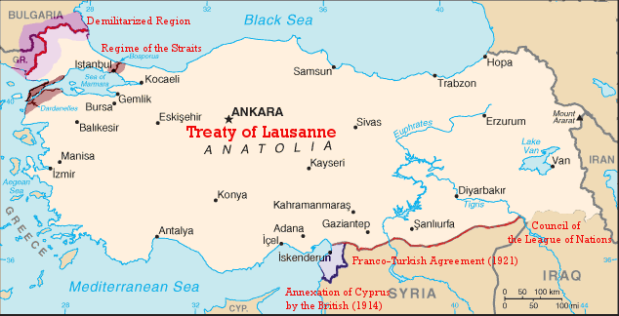
The Treaty of Lausanne
Map of the territorial borders of Turkey after the Treaty of Lausanne, 1923.
(Wikimedia Commons, Public Domain)
The Treaty of Sèvres, imposed on the Ottoman Empire in 1920, could not be maintained after the complex political changes brought about by the emergence of the Turkish Republic under the leadership of Mustafa Kemal. When Turkey was successful in invading and occupying Anatolia in the Turkish-Greek War, it was necessary to replace Sèvres with a new treaty, negotiated under British supervision at Lausanne.
The revision of the borders at Lausanne did not significantly alter the partition of the Ottoman Empire. It was now a complex patchwork of new states in the Middle East and Northern Africa, with the areas of influence assigned jointly by the Allies, in particular Great Britain and France.
But Lausanne involved massive and painful exchanges of population. More than a million Orthodox Christians were forcibly removed from Anatolia and Eastern Thrace; half a million Muslims were expelled from Greece. This mass upheaval left a bitter legacy for the future; and was a stark illustration of the immense difficulties of implementing the principle of self-determination.

Slide 30
Assessing the Peace Treaties
J.M. Keynes accused the Treaty of Versailles of being unreasonable and exceedingly punitive, and hinted that personal resentments and prejudices, such as those of Georges Clemenceau, impacted negatively on the prospects for future peace. Etienne Mantoux, in 1946, wrote a rebuttal of Keynes’s arguments, and argued that the Treaty was not unreasonable and was not the cause of the subsequent crises that led, ultimately, to the Second World War.
"[Clemenceau] took the view that European civil war is to be regarded as a normal, or at least a recurrent, state of affairs for the future, and that the sort of conflicts between organised Great Powers which have occupied the past hundred years will also engage the next. According to this vision of the future, European history is to be a perpetual prize-fight, of which France has won this round”
"A research on the nature of the economic disasters caused by the Treaty would not take us far – or, in fact, it takes us too far from our path. Doubtlessly, nothing much was easy during the ten years after the war; the economic recovery was not immediate, and none could have expected otherwise, after four years of destruction and disintegration without precedents. (…) All these evils were the heritage of the war, and not of the Treaty. (Mr Keynes) does not explain how the Treaty might have possibly caused them.
(J.M.Keynes, The Economic Consequences of the Peace, 1919)
(Etienne Mantoux, The Slandered Peace, 1946 )

Slide 31
Hopes and fears for the future of peace
Despite the complex problems and continuing conflicts of 1918-1923, the end of the First World War was accompanied by an outpouring of optimism about the future of Europe and the world. There was widespread belief in American democracy and ‘Wilsonian idealism’. The emergence of new national states seemed to promise a new and better future. The League of Nations seemed to guarantee a future of collective security and the peaceful resolution of international disputes. The end of the ‘war to end all wars’ seemed to point towards worldwide disarmament and the end of militarism. The upturn in the world economy from 1924 seemed to provide a secure basis for international cooperation. The Locarno treaties in 1925 seemed to indicate a new era of reconciliation that would overcome the hostilities and suspicions that had challenged the Paris Peace Settlement. But this optimism did not completely dispel the continuing uncertainty about the future of the peace. Beneath the fragile optimism of the ‘Locarno Honeymoon’ there were deep anxieties about the future of the peace. The continued diplomatic isolation of Soviet Russia left unanswered questions about the security of Poland and other Successor States in East Central Europe. Many Europeans, especially in France, worried that the United States was not committed to maintaining the ‘Versailles system’ that America had done so much to bring into existence. Many people, especially in Britain, worried that the treatment of Germany in 1919 had been too punitive, others thought it too lenient. There was still hope that peace could be maintained by international cooperation and compromise; but it remained an uncertain peace.

Slide 32
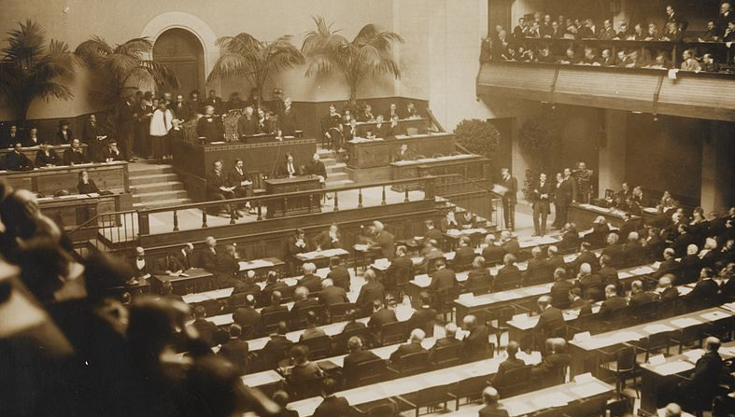
The League of Nations
The opening ceremony of the League of Nations, 15 November 1920.
(Norwegian National Library, Photographer: A. Frankl, Public Domain in Norway)
All treaties signed at the Paris Peace Conference contained a peculiar first section. It was the Covenant of the League of Nations, a proper Wilsonian creature. The US President saw the League as the perfect tool to provide the countries of the world with a forum which could debate, discuss and solve issues before they went out of hand, and ensure collective security for the world itself. The Covenant expressly focused on conflict resolution through arbitration and collective disarmament.
Such an ambitious programme was not necessarily shared by European leaders. Many historians think that the British and French leaders accepted Wilson’s request out of tactics rather than convictions. It holds true, though, that, as doubtful as they were, some leaders did understand the rationale behind containing disputes within an international forum.

Slide 33
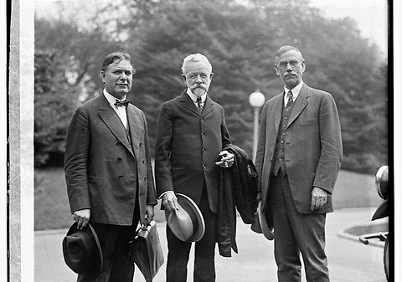
American opposition
American rejection of the League of Nations in March 1920, when the US Senate voted against ratification of the Treaty of Versailles, was a heavy blow to hopes for success of the League. Two of the most persuasive opponents of ratification were William Borah of Idaho (left) and Henry Cabot Lodge of Massachusetts (centre).
(National Photo Company/Library of Congress, Public Domain)
French leaders, especially Georges Clemenceau, invested considerable energies on collective disarmament, because they saw it as a possible solution for what they thought of as ‘the German threat’. Clemenceau hoped that the post-war peace settlement would be underpinned by the power and prestige of the United States. But he was suspicious about the firmness of Washington’s commitment.
In March 1920, hopes for the effectiveness of the League of Nations were badly damaged by the decision of the US Congress, in open opposition to President Wilson, to deny ratification of the Covenant (and the related Peace Treaties). The League did not, therefore, include among its members the world power that had done most to bring about the formation of the League in the first place.

Slide 34
Eduard Beneş, Foreign Minister of Czechoslovakia, explains the need for the Little Entente
The new states which in Central Europe have taken the place of the Hapsburg monarchy owe their creation to the living will of the peoples who for centuries had been oppressed in Austro-Hungary, and who had in vain endeavoured to secure the necessary conditions for a free and full development of their economic and cultural life. The revolutionary activities of these peoples…were the expression of this will which could only be acted upon successfully because the European War created the pre-conditions for a new adjustment of Europe and because the substitution of new independent states for the Austro-Hungarian monarchy was not only an act of historic justice but at the same time in the interests of Europe generally. The Danubian monarchy was the outward expression of a German-Magyar system of violence and the living negation of those ideals which brought half Europe and America into war. Its removal was a manifest necessity as an insurance against future dangers and in order to secure the triumph of the principles for which the war was fought. The changes which have thus been made in Central Europe are, of course, greater than any which have taken place in other parts of the continent. An entire great state has been obliterated from the map of Europe; the frontiers of new states have been delimited. With their creation, the possibility of a better, brighter future opens before us.
After the War, the countries of Central and Eastern Europe were completely transformed. In place of the old multinational empires there were now a collection of Successor States – new national states established according to the principles of self determination. In theory, self-determination would have led to the formation of ethnically homogenous States; but this is not what happened in reality. The new states contained minority populations with diverse languages, religions and identities. They were also small states with very limited military potential. For security they would have to depend heavily on the League of Nations, and on the Great Powers, such as France.
So the birth of these new national states was accompanied by great optimism, but also by deep fears. Would they join together as successful democracies? Or would they be fatally weakened by internal divisions and by the threat of aggression from neighbouring powers?
Eduard Beneş, The Little Entente, Foreign Affairs, September 1922

Slide 35
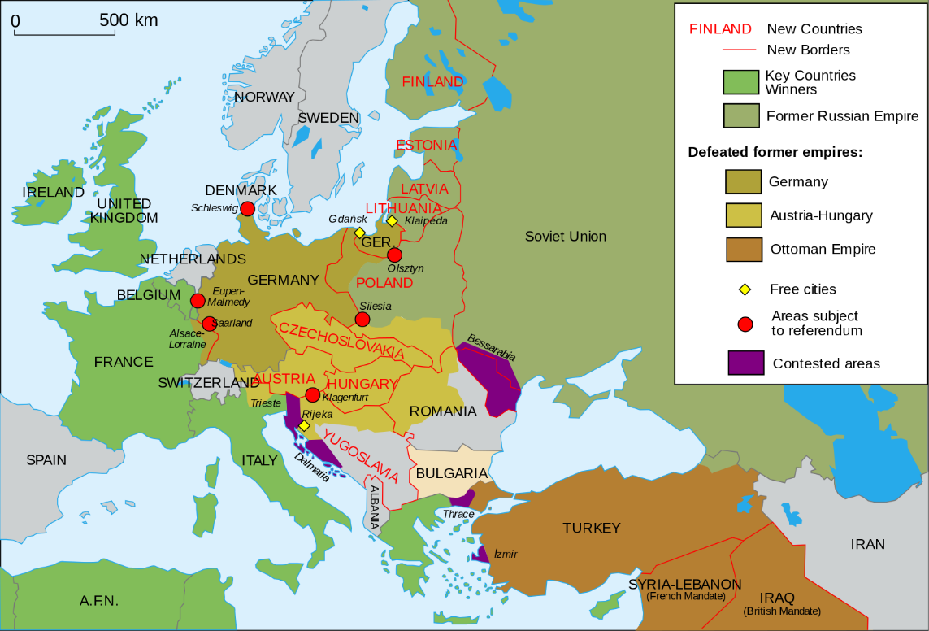
The Pact of Locarno
A map of Europe in 1923 showing the borders of new national states superimposed on pre-war Europe.
(Wikimedia Commons, CC BY-SA 2.5 generic)
The Successor States were militarily weak and feared attack from their more powerful neighbours, especially Germany and Soviet Russia. So they wanted an alliance with Germany’s traditional foe, France. The result was the so-called Little Entente, a pact signed by Romania, Czechoslovakia, and Yugoslavia in 1920-21, and supported by France via bilateral treaties. France wanted the Little Entente in order to control Germany’s Eastern borders, but the countries of the Little Entente wanted it to hold back Hungary’s ambition to restore its pre-war borders. The Little Entente, therefore, represented both hope for future collective security and fear of future annexation.
French leaders sensed that the Little Entente would not be enough. In 1925 France and Germany signed the historic Pact of Locarno, which locked the two countries into a series of guarantees designed to ensure peace. Despite the optimism raised by Locarno, French military leaders feared that the Pact focused too much on the shared borders in the West – but not on Germany’s eastern borders. The main concerns for the future of the peace rested on Central and Eastern Europe.

Slide 36
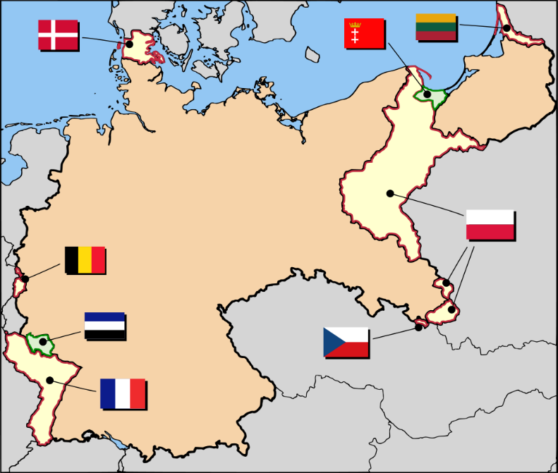
German territorial losses after the Treaty of Versailles
The territories ceded to other countries as prescribed by the Treaty are shown in white; League of Nations mandates for the Rhineland and for Danzig are shown in green; the flags indicate the countries to whom territory was transferred.
(Netherlands Wikipedia, CC BY-SA 2.5 generic)
The Treaty of Versailles imposed several territorial losses on Germany, Though still resented, it was easier for most Germans to accept the changes to western borders than those in the East. After 1919, the Allied powers, especially France, were eager to secure voluntary German commitment to uphold the terms of the treaty. This was achieved at Locarno in 1925, when Germany and France, with Britain and Italy as guarantors, signed treaties recognising the 1919 borders, or at least renouncing the use of force to alter them.
‘Western Locarno’ secured permanent acceptance of Germany’s frontiers with France, Luxemburg and Denmark. ‘Eastern Locarno’, dealing with the city of Danzig, the ‘Polish Corridor’ between Germany and East Prussia, the German-speaking Sudetenland, now part of Czechoslovakia, and Memel, which had been ceded to Lithuania, was more ambiguous. Germany undertook not to alter these borders by aggression, but did not accept that they should necessarily be permanent.

Slide 37
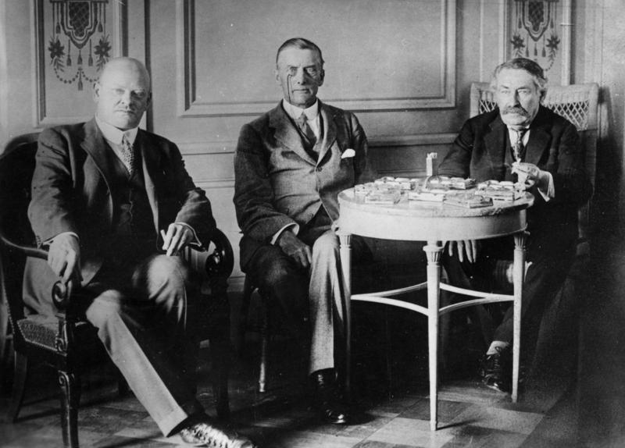
The ‘Stresemann-Briand Partnership
Locarno, 1925. Gustav Stresemann, German foreign minister (left). Aristide Briand, French foreign minister (right). Austen Chamberlain, British foreign minister (centre).
(Bundesarchiv, Bild 183-R03618 / CC-BY-SA 3.0)
Few developments in international relations in the 1920s fostered as much optimism as the signing of the Locarno treaties in 1925. The Locarno agreements signalled a new era of cooperation and reconciliation between France and Germany, based on the close diplomatic alliance between their foreign ministers.
For France, Aristide Briand believed that true security depended upon partnership with Germany, rather than total reliance on anti-German alliances. For Germany, Gustav Stresemann was convinced that a policy of ‘fulfilment’ was essential – bringing Germany out of international isolation by renouncing the use of force and proving that Germany could be a trusted neighbour.
For the wider international community, the agreements signed voluntarily at Locarno were reassuring evidence that the post-war peace settlement was much more secure. Britain and Italy acted as neutral moderators at Locarno, reinforcing the message of international acceptance of the ‘Versailles system’.

Slide 38
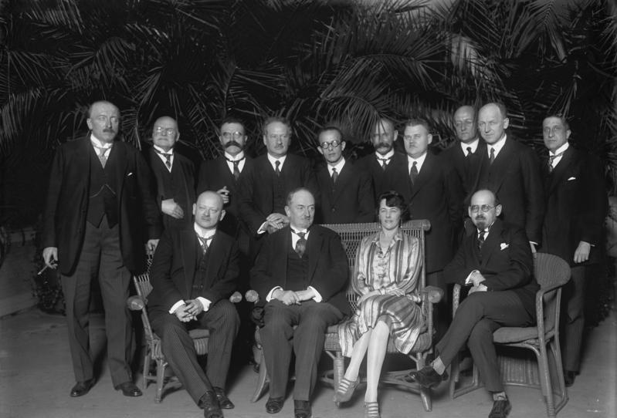
The isolation of the USSR
Grigori Chicherin, Soviet Commissar for Foreign Affairs sitting between Gustav Stresemann and his wife at a diplomatic reception in Berlin, 1928
(Bundesarchiv, Bild 183-R03618 / CC-BY-SA 3.0)
The diplomatic isolation of Soviet Russia was a factor that weakened the security of the post-war peace. On the one hand, western leaders regarded the USSR as a dangerous enemy, that was very difficult to negotiate with. On the other hand, the situation in eastern Europe was very unstable and Soviet Russia was a potential threat. In the mid-1920s some moves were made to normalise relations. The USSR made a treaty with Germany at Rapallo in 1922. This was extended by the 1925 Treaty of Berlin. The Soviet Commissar for Foreign Affairs, Grigori Chicherin, and his able, charming deputy, Maxim Litvinov established links with many western politicians and diplomats, especially with the German foreign minister, Gustav Stresemann. Litvinov also gained friendly contacts in France.
In the years of prosperity for the world economy, it seemed that the USSR might become a reliable trading partner. But there was still a gulf of suspicion between East and West. Uncertainty about Soviet Russia’s intentions was still destabilising the post-war peace.

Slide 39
Economic prosperity
By 1924, the post-war hurricanes had calmed down, and it seemed possible to look forward to a return to what an American president called ‘normalcy’. There was indeed a return to something like global economic growth, even though some of the producers of raw materials and foodstuffs, including notably North American farmers, were troubled because prices of primary products turned down again after a brief recovery. Moreover, unemployment in most of western Europe remained, by pre-1914 standards, astonishingly high. It is hard to remember that, even in the boom years of the 1920s (1924-1929), it averaged between 10 and 12 per cent in Britain, Germany and Sweden. Only the USA, with average unemployment of 4 per cent, was really an economy under full steam. Nor should we overlook the fact that the boom, such as it was, was largely fuelled by the enormous flows of international capital which swept across the industrial world in those years, especially to Germany.
One factor that seemingly enhanced the prospects for future peace and security in the 1920s was the prosperity of the world economy. Increased production, rising living standards, and the availability of American loans, all helped to bring greater political stability and improved trade relationships.
In this context, there was much more optimism about international cooperation and moves to strengthen the peace. Growing economic prosperity was one factor, for example, in the reconciliation between France and Germany, and in the signs that relations between Soviet Russia and the West might improve.
Economists and historians still disagree about the extent of the success of the world economy in the ‘Golden Years’ of the 1920s, and how far this prosperity strengthened the ‘Versailles system’. The views of the British historian Eric Hobsbawm, written in 1994, reflect this ambivalence.
(Eric Hobsbawm, The Age of Extremes (1998 edn) London, pp.90-91)

Slide 40
The role of Stresemann
In my opinion there are three great tasks that confront German foreign policy in the immediate future. In the first place, the solution of the Reparations question in a sense tolerable for Germany, and the assurance of peace, which is an essential premise for the recovery of our strength.
Secondly, the protection of Germans living abroad, those 10 to 12 millions of our kindred who now live under a foreign yoke in foreign lands.
The third great task is the readjustment of our eastern frontiers; the recovery of Danzig, the Polish Corridor, and a correction of the frontier in Upper Silesia.
From a letter sent to the Crown Prince (eldest son of Kaiser Wilhelm II) by Gustav Stresemann in 1925.
(This letter only became public in 1932, after Stresemann’s death)
During the period of optimism about the prospects for international peace in the later 1920s (The Locarno Honeymoon), there was great faith in Germany’s long-serving foreign minister, Gustav Stresemann; and especially in the Franco-German rapprochement built on Stresemann’s partnership with Aristide Briand. But beneath the optimism, doubts remained about the strength and permanence of the Locarno agreements.
While the agreements relating to Germany’s western borders were based on full German acceptance of the Treaty of Versailles, the agreements relating to Germany’s eastern borders were based not on acceptance, but on Germany’s promise not to use force to change the situation. Some observers at the time noted this potentially dangerous loophole. Stresemann died in 1929, still highly regarded in the West as a peacemaker. But evidence that came to light after his death indicated that he had continued to believe that, one day, Germany’s eastern borders would be radically revised, especially with Poland, but also with Austria and Czechoslovakia.
(Anthony Adamthwaite, The Lost Peace, 1981)

Slide 41



The uncertain peace
This collection has been made by Francesco Scatigna and Chris Rowe of the Historiana editing team
(US Army Signals Corps, Public Domain)

